Slide 1
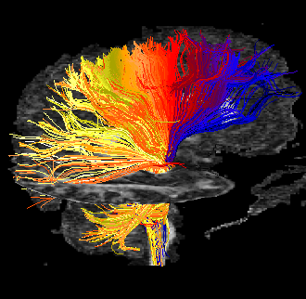

White Matter Tractography
MP/NTP 651

Slide 2
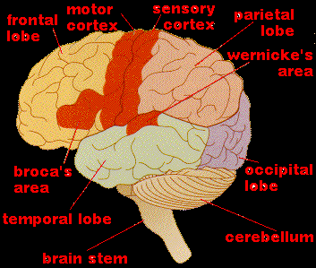
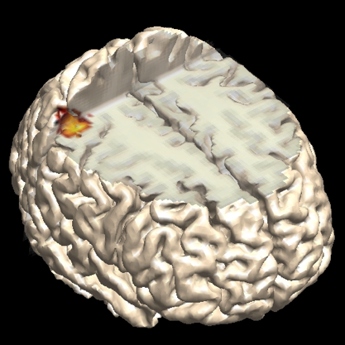
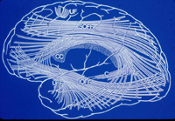
Functional Brain Tissues
Gray Matter – “Processing Centers”
White Matter – “Interconnections”

Slide 3
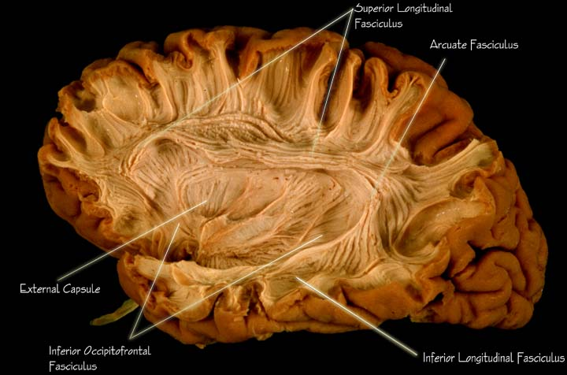
Anatomical Dissection
c/o J. Medow, Univ. of Wisconsin - Madison
Brainmind.com

Slide 4
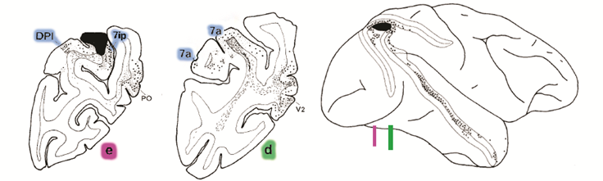
Tracer Labeling
Cavada and Goldman-Rakic 1989
Notes:
Histological Tracers are considered the gold standard

Slide 5
White Matter Tractography

Slide 6
Overview
Streamline/Deterministic Tractography
Probabilistic Tractography
Connectomics

Slide 7
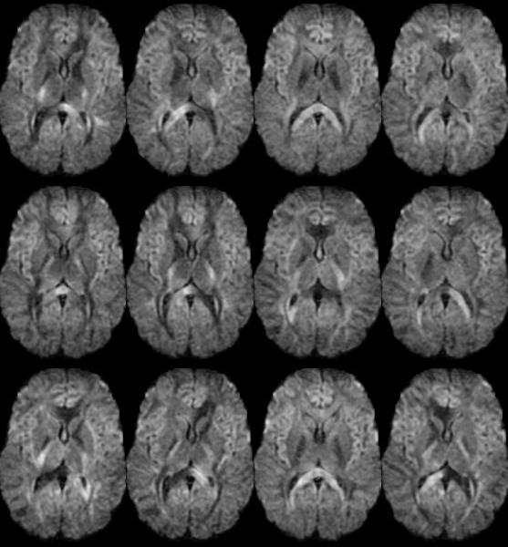
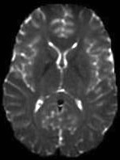
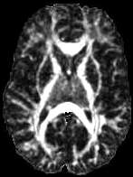
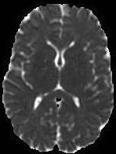
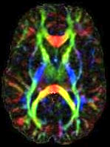
Diffusion Tensor Imaging
DW images

Slide 8

The Diffusion Tensor
z
z
ε₁, λ₁
ε₂, λ₂
y
y
ε₃, λ₃
x
x
D_{ii}>0
Eigenvalues
D_{ij}=D_{ji}
Diffusion Tensor
Matrix of 3 eigenvectors
Notes:
Diffusion anisotropy is characterized by a 3x3 tensor. A tensor is simply a mathematical construct that can be thought of as an ellipsoid in three-dimensionsal space.
Diffusion properties of water are measured using spatial coordinates x, y, and z. The directional diffusivities are calculated from images obtained by applying diffusion-sensitizing gradients.
A property of tensors is that they can be diagonalized, leaving only three nonzero elements along the main diagonal of the tensor- the eigenvalues (lambda1,2,3) which reflect the size of the ellipsoid, and three eigenvectors, which reflect the orientation of the ellipsoid axes in 3D space. The orientation of the principle eigenvector is assumed to reflect fiber direction and can be color coded voxel by voxel.

Slide 9
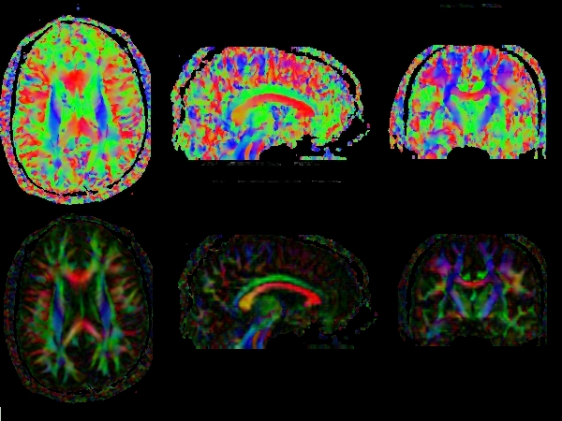

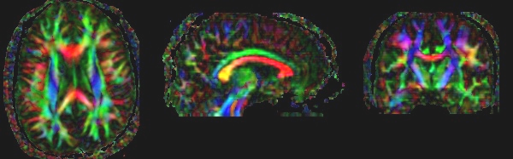
Tensor Orientation – Major Eigenvector
FA *
Red = R/L; Green = A/P; Blue = S/I

Slide 10
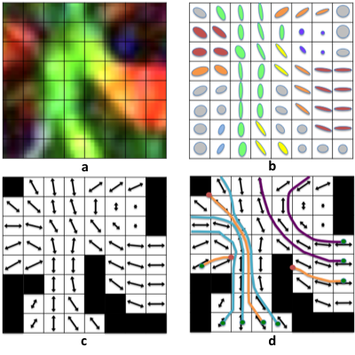
Figure 1
Figure 1. DTI representations of DTI orientation information. A box centered on a region
containing the genu of the corpus callosum and anterior limb of the internal capsule is
blown up and cartoon examples of directional information are shown. The most common method
for describing the orientation is the eigenvector color map (a). Ellipsoidal glyphs (b) and vector maps have
also been used to depict the local organization of the diffusion tensor field. Using the
eigenvector information, the fiber trajectories may be estimated using tractography (d).

Slide 11
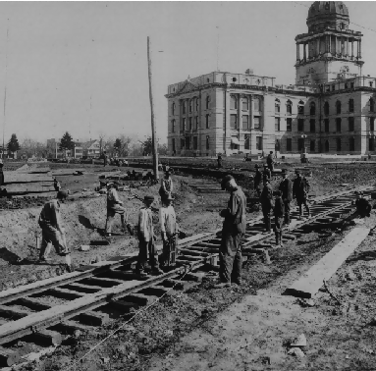
Tract Construction

